Slide 1
COMP6049 – Algorithm Design and Analysis
Topic 19-20 – String Matching

Slide 2
Outline Materials
Naïve String-Matching Algorithm
The Knuth-Morris-Pratt Algorithm

Slide 3
String Processing
String are constructed from a set of zero or more characters
“I think, therefore I am.”
“Practice makes perfect!”
A character can be a letter or symbol
“5” → letter
“!” → symbol
Some of applications that involve string processing are:
Text Editing
Spell Checking
Similarity Checking

Slide 4
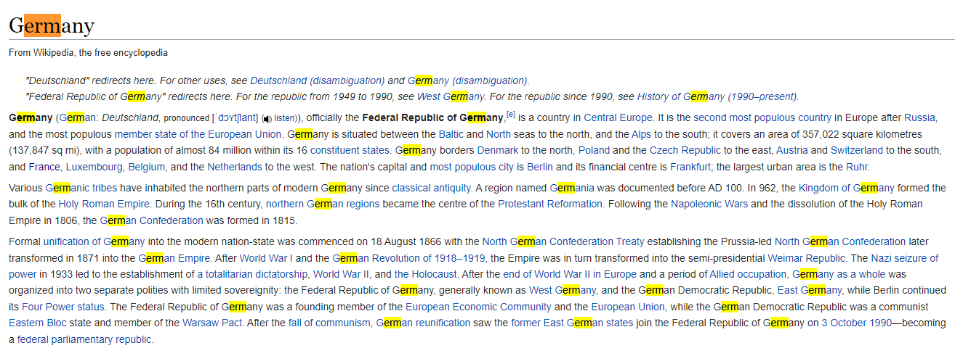
String Processing Applications (1)
Search the string “erm” in the document (https://en.wikipedia.org/wiki/Germany)

Slide 5
String Terminology
Length: the number of characters in a string.
Zelda → five characters
Null String: A string of length 0. It is also known empty string
Suffix: any substring of the string which start from the end of the string.
Example : banana, the suffixes are a, na, nana, anana, banana
Prefix: any substring of the string which start from the beginning of the string.
Example : banana, the prefixes are b, ba, ban, bana, banan, banana

Slide 6
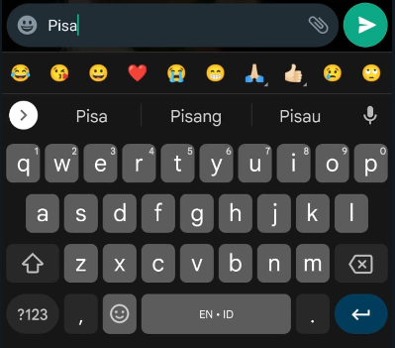
String Processing Applications (2)
Autocomplete: predicts the rest of a word a user is typing.
How it works?
It involves showing a pop-up list of possible completions for the current input prefix to allow the user to choose the right one.

Slide 7
String Processing Problem Pattern Matching Algorithm
A pattern matching algorithm can be stated as how to check whether pattern P is exists in string S or not, and also where the pattern P appears in string S.
Problem : we want to search pattern “aab” in string “aaaaab”
Input : aab
Output : pattern “aab” exist at the index 3 of “aaaaab”

Slide 8
Naïve String Matching Algorithm
Pattern Matching Algorithm

Slide 9
Naïve String Matching Algorithm
A naïve string-matching algorithm is an example of a brute force algorithm.
This algorithm accepts a text (length n) and a pattern (length m) and checks m characters from the first position of the text.
If there is mismatch, the pattern is shifted by one position.
On the other hand, if there is a match, then the next character is checked.

Slide 10
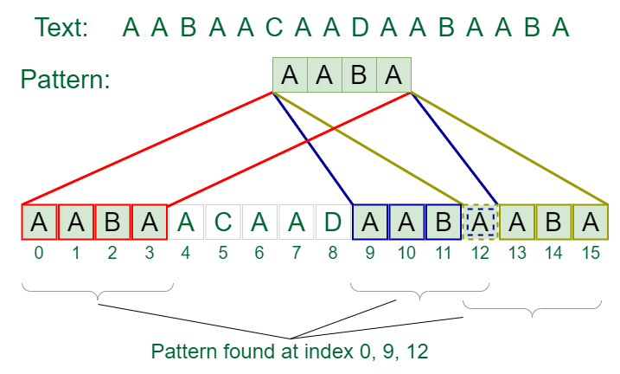
Naïve String Matching Algorithm
Image Source

Slide 11



Example Naïve String Matching
Problem: We want to search Pattern aab in String aaaaab
Start Algorithm
Loop 1
Loop 2
Loop 3

Slide 12

Example Naïve String Matching
Loop 4
Match found in this loop
End Algorithm

Slide 13
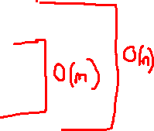
Naïve String Matching Algorithm
Time complexity is O(nm) worst case:
Outer loop is O(n) iteration
Inner loop is O(m) iteration worst case
int string_match(string &sourceText, string &searchText)
{
int sourceLength = sourceText.length();
int searchLength = searchText.length();
for (int i=0; i+searchLength-1 < sourceLength ; i++) {
bool found = true;
for (int j = 0; j < searchLength; j++) {
if (sourceText[i+j] != searchText[j]) {
found = false; break;
}
}
if (found) { return i; }
}
return -1;
}

Slide 14
The Drawbacks of Naïve String Matching Algorithm
Let’s look at this example:
String:
Pattern:
a | b | c | d | a | b | c | a | b | c | d | f
1 | 2 | 3 | 4 | 5 | 6 | 7 | 8 | 9 | 10 | 11 | 12
a | b | c | d | f
1 | 2 | 3 | 4 | 5
The comparison is repeatedy performed whenever there is a mismatch by backtracing i by one position.

Slide 15
The Knuth-Morris-Pratt Algorithm
Pattern Matching Algorithm

Slide 16
The Knuth-Morris-Pratt Algorithm
Goals: The objective of this algorithm is to minimize the total number of comparison between pattern P and text T.
Pattern: abcdabc
Prefix: a, ab, abc, abcd
Postfix: c, bc, abc, dabc
In the pattern, is there any prefix same as suffix?

Slide 17
The Knuth-Morris-Pratt Algorithm
P1: a b c d a b e a b f
0 0 0 0 1 2 0 1 2 0
P2: a b c d e a b f a b c
0 0 0 0 0 1 2 0 1 2 3
P3: a a b c a d a a b e
0 1 0 0 1 0 1 2 0 0
P4: a a a a b a a c d
0 1 2 3 0 1 2 0 0

Slide 18
The Knuth-Morris-Pratt Algorithm (1st Example)
String:
a b a b c a b c a b a b a b d
1 2 3 4 5 6 7 8 9 10 11 12 13 14 15
Pattern:
Index: 0 1 2 3 4 5
Pattern: a b a b d
0 0 1 2 0 → LPS
With KMP, the i index will not backtracking

Slide 19
The Knuth-Morris-Pratt Algorithm (2nd Example)
String:
A A A A A A A A A A A A B
1 2 3 4 5 6 7 8 9 10 11 12 13
Pattern:
Index: 1 2 3 4 5
Pattern: A A A A B
0 1 2 3 0

Slide 20


The Knuth-Morris-Pratt Algorithm
The objective of this algorithm is to minimize the total number of comparison between pattern P and text T.
Example :
A naive string matching proceeds this following manner : T[3] != P[3], the algorithm slides the pattern by 1 character.
This is not effective, in KMP algorithm the slides will be :

Slide 21
The Knuth-Morris-Pratt Algorithm
The KMP Algorithm extract information about better shifts based on the pattern itself
The KMP Algorithm works in two stages :
Preprocess the pattern to obtain information so that trivial comparisons can be reduced (generate failure function / prefix function)
Use failure / prefix function for determining the better shifts for effective pattern matching

Slide 22
KMP Algorithm Prefix Function
We want to search Pattern aaab in String aaaaaab
Build failure function
i = 0, string pattern until index 0 is a. so we cannot compare prefix and suffix from this index. The value become 0.
i = 1, string pattern until index 1 is aa.
Suffix =a, prefix = a. because the suffix and prefix is match 1 character, the value become 1.
i = 2, string pattern until index 2 is aaa.
Prefix | Suffix | Match value
a | a | 1
aa | aa | 2

Slide 23
KMP Algorithm Prefix Function
From table before, the biggest match value is 2, so the value for this index is 2
i=3, string pattern until index 2 is aaab.
From table above, the biggest match value is 0, so the value for this index is 0.
Prefix | Suffix | Match value
a | b | 0
aa | ab | 0
aaa | aab | 0

Slide 24
KMP Algorithm Prefix Function
From process before, we get the failure function as follows :
i | F(i)
0 | 0
1 | 1
2 | 2
3 | 0

Slide 25
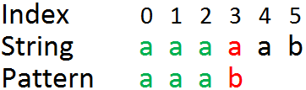
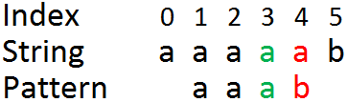
KMP Algorithm Example
Loop 1
According to process above, the last correct character is in index 2, so we can see in the failure function F(2) = 2.
Failed at position 3, so we can jump by 3 – F(2) = 1
Loop 2, we can start from index 1 according to the failure function before.

Slide 26
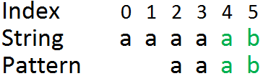
KMP Algorithm Example
According to process before, the last correct character is in index 2, so we can see in the failure function F(2) = 2.
Failed at position 3, so we can jump by 3 – F(2) = 1
Loop 3, we can start from index 2 according to the failure function before.
Match found in this loop
Total time complexity of KMP is O(n+m) worst case :
For matching takes O(n) time
Generate failure function need O(m) time

Slide 27
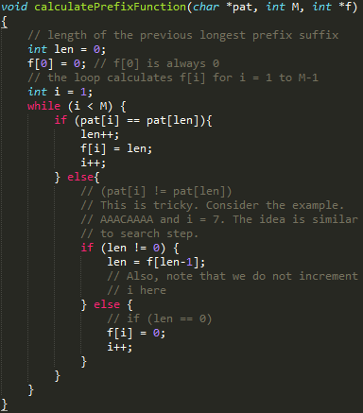
Knuth Morris Pratt’s (KMP) Algorithm

Slide 28
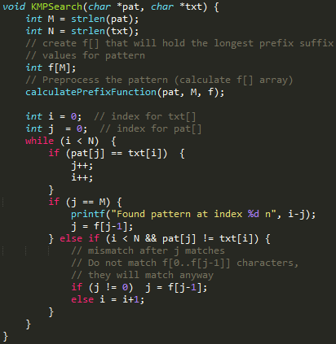
Knuth Morris Pratt’s (KMP) Algorithm

Slide 29
Exercise
Given a text string,
“ABABABABAABABABABAAAAAAAA”
You are to determine whether string pattern "ABABABAB" is exists or not in the text string. For this problem, you have to calculate the prefix function (failure function/failure table) and simulate the string matching for Knuth-Morriss-Pratt algorithm

Slide 30
Q & A

Slide 31
References
S. Sridhar. 2014. Design and Analysis of Algorithms, 1/e. Oxford University Press. India. Chapter 16
String
http://algo.is/aflv16/aflv_11_strings.pdf
String Algorithm
http://whocouldthat.be/visualizing-string-matching/
Knuth-Morris-Pratt String Search
http://people.ok.ubc.ca/ylucet/DS/KnuthMorrisPratt.html

Slide 32
THANK YOU

